Slide 1
Online Virtual Trial Room Implementation using OpenCV Python

Slide 2
Front end
HTML
CSS
Javascript
Django
Bootstrap
Back end
Python
JavaScript
MongoDB/PostgreSQL
Database Administrator
OpenCV
Convolution Neural Network
Machine Learning
Virtual Reality
Artificial Intelligence

Slide 3
Model
Start
Input camera detector
1
Load Marker
Generate frame
Virtual Environment
generation
Body
Show the result
Save the result
Axes generation
Draw function
Draw object
Stop
1

Slide 4
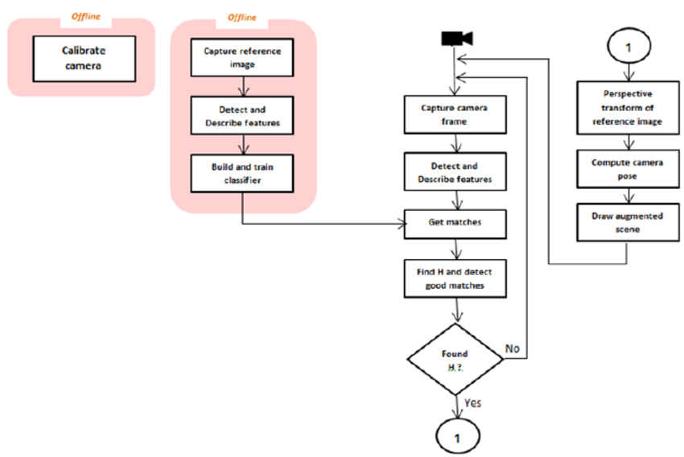

Slide 5
Camera
In Device
virtual / mixed
scene generator
Sensing Surroundings
3D environment capture
Display
Video(which user see)
Sensing user body / pose and gesture
Gesture pose recognize
Video(what user does)

Slide 6
First Page
Basic Home page using HTML and CSS

Slide 7
Second Page
Dashboard Select Gender
Male
Female

Slide 8
3rd page for Facial model
Open Opencv for male
Detect clothes for male
Upper body
Lower body
Full body

Slide 9
3rd page for body model
Open Opencv for female
Detect clothes for Female
Upper body
Lower body
Full body

Slide 10
4th page for final output
Selected or Purchased Item
Final result of Item which user selected

